Slide 1

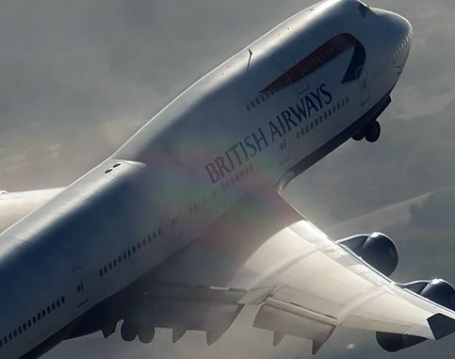
British Airways Virtual Internship
Web Scrapping : Data Extraction (Data Gathering) and Data Analysis.
Analysing the Customer Behaviour based on their reviews

Slide 2
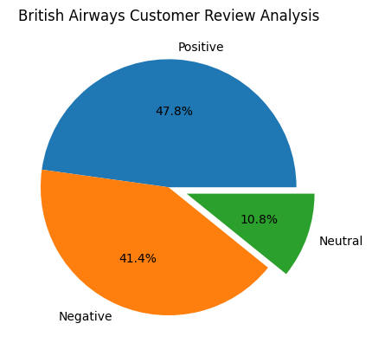
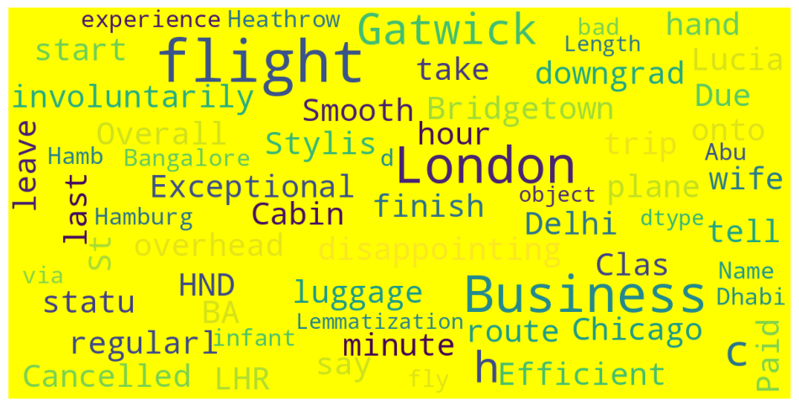

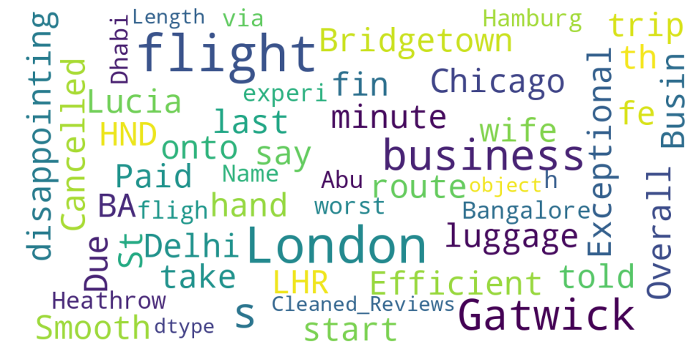
Customer Review Analysis:
Number of Trips Verified = 813
Number of Not Verified = 187
Number of Positive Reviews = 521
Number of Negative Reviews = 373
Number of Neutral Reviews = 106

